Slide 1
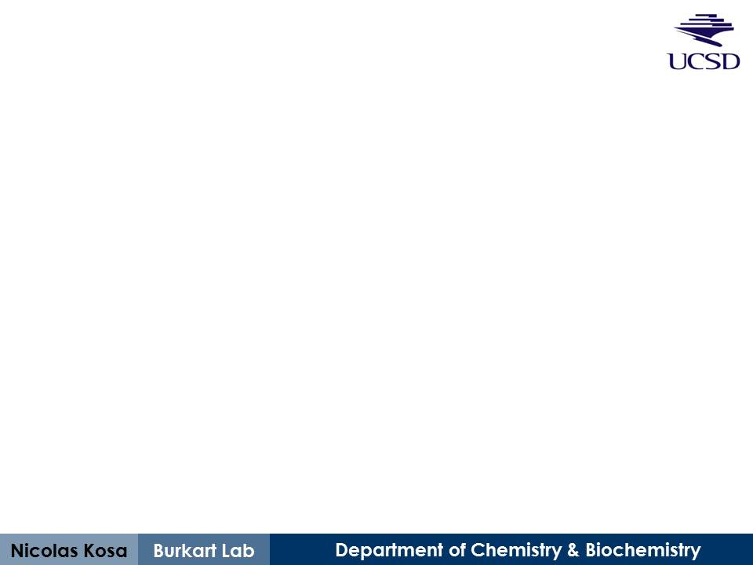
Spot-peptide synthesis #2 Results
Treatment of spot-peptide array with Sfp and PfAcpH
October 18th, 2013

Slide 2
Basic Procedure
Peptide synthesis (step 0)
Conducted on PEGylated (PEG500) cellulose membrane with Intavis spot-array synthesizer
Sfp Reaction (step 1)
20 μM rhodamine-maleimide-CoA
1 μM Sfp, 2 hours at 37°C
PfAcpH Reaction (step 2)
Utilized membrane post-Sfp reaction
2 μM PfAcpH, 16 hours at 37°C
General
1 M NaCl triple wash post-reaction (reduce non-specific fluorescence)
Typhoon 532 nm excitation / 580 nm emission
All image processing performed in ImageJ (NIH)

Slide 3
Associated files
“2013-10-10_Peptide Set #2 Results-combined.xls”
Peptide names & sequences
Membrane map with peptide names
Integrated densities: Sfp → PfAcpH (2nd reaction)
Tab: “Pf-retake-result” using background substracted values
Integrated densities: Sfp (1st reaction)
Tab: “Sfp-result”
“2013-10-10_Peptide Hits.xls”
Top 43 “hits” displaying fluorescence drop after PfAcpH treatment
Also contains peptide alignment and C/K/R amino acid counts for false-positive considerations

Slide 4
Notes about density calculations
“.TIF” files were integrated this time instead of “.gel”, so the intensities this round are not directly comparable to last round
“RawIntDen” was used for density calculations with background subtraction (“RawIntDen” is merely a direct multiple of “IntDen”)
The integrated densities for the first Sfp reaction were obtained before horizontally flipping the image, so I used an excel function that reverses the order of the raw data for “Sfp-result” before background subtracting.

Slide 5
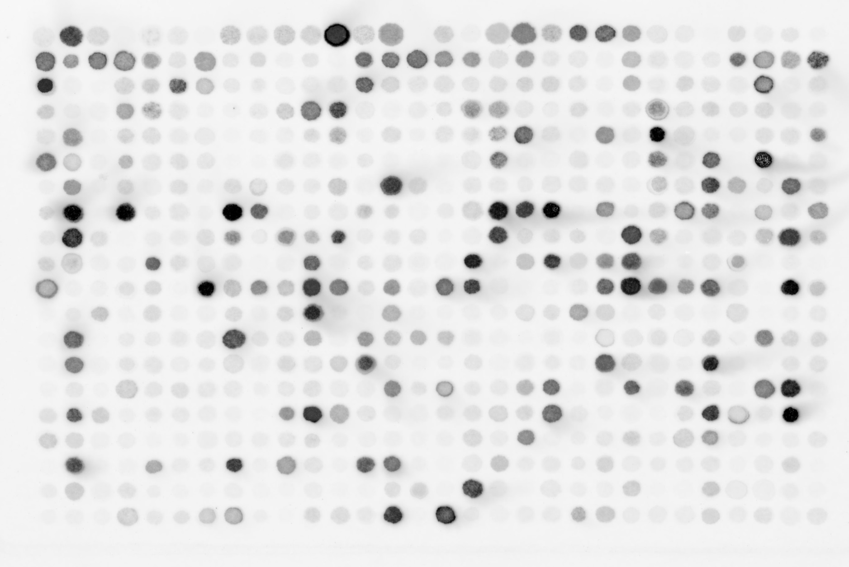
Peptide Synthesis #2- Sfp
 | 1 | 2 | 3 | 4 | 5 | 6 | 7 | 8 | 9 | 10 | 11 | 12 | 13 | 14 | 15 | 16 | 17 | 18 | 19 | 20 | 21 | 22 | 23 | 24 | 25 | 26 | 27 | 28 | 29 | 30
A
B
C
D
E
F
G
H
I
J
K
L
M
N
O
P
Q
R
S
T

Slide 6
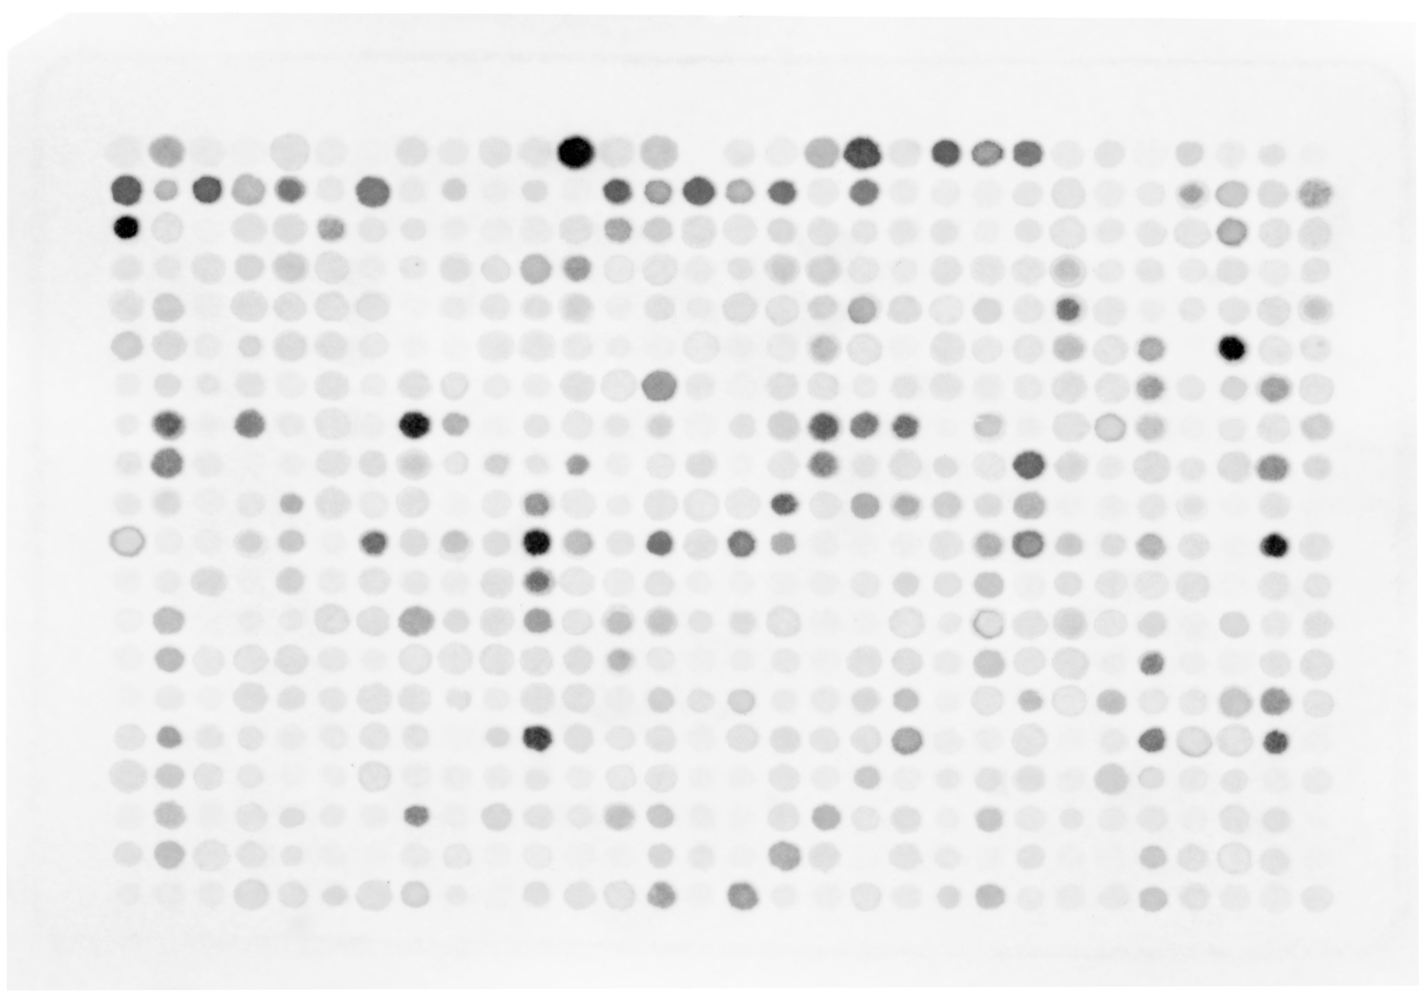
Peptide Synthesis #2- Sfp → PfAcpH
 | 1 | 2 | 3 | 4 | 5 | 6 | 7 | 8 | 9 | 10 | 11 | 12 | 13 | 14 | 15 | 16 | 17 | 18 | 19 | 20 | 21 | 22 | 23 | 24 | 25 | 26 | 27 | 28 | 29 | 30
A
B
C
D
E
F
G
H
I
J
K
L
M
N
O
P
Q
R
S
T

Slide 7
decreased fluorescence
increased fluorescence
 | 1 | 2 | 3 | 4 | 5 | 6 | 7 | 8 | 9 | 10 | 11 | 12 | 13 | 14 | 15 | 16 | 17 | 18 | 19 | 20 | 21 | 22 | 23 | 24 | 25 | 26 | 27 | 28 | 29 | 30
A |  |  |  |  |  |  |  |  |  |  |  |  |  |  |  |  |  |  |  |  | -117 | 586 | -599 | 77 | -66 | -8 | -72 | -12 | -50 | -6
B | -301 | 267 | -396 | 695 | -590 | 37 | -821 | -19 | -115 | -59 | -131 | -49 | -291 | 492 | -133 | 392 | -526 | 142 | -491 | 68 | 67 | -17 | 487 | -69 | 26 | 0 | 509 | 623 | 599 | 1058
C | -267 | -216 | -49 | 89 | 55 | 687 | 381 | -79 | -6 | -31 | 50 | -44 | 888 | -72 | -130 | 45 | -127 | 19 | 180 | 216 | 10 | -7 | 490 | -101 | 163 | 27 | -83 | 912 | -75 | 31
D | 192 | -19 | -219 | 539 | 163 | -154 | -81 | -113 | -178 | 158 | 1028 | 1019 | -27 | -224 | -17 | -23 | 594 | 418 | 0 | -13 | 34 | -139 | -56 | 623 | 132 | 171 | 103 | 98 | 150 | -37
E | -41 | 745 | -49 | -49 | -71 | -200 | -163 | -2 | -62 | -122 | -18 | 266 | -16 | -22 | -81 | -163 | -71 | 362 | 1047 | -36 | -83 | 988 | -9 | 1276 | 263 | 84 | -20 | 40 | -56 | 505
F | 1227 | 110 | -24 | 261 | -167 | -44 | 14 | -19 | 2 | -7 | -99 | -67 | 34 | 28 | -92 | -5 | 29 | 683 | -64 | 60 | -34 | -79 | -73 | 716 | 100 | 950 | 114 | -35 | 123 | 53
G | -7 | 886 | 42 | 255 | 59 | -24 | 31 | 36 | 135 | 60 | 38 | 268 | -117 | 1345 | 361 | 12 | -128 | -116 | 27 | -12 | -58 | 48 | -71 | 196 | 35 | 1130 | 649 | -5 | 871 | 142
H | 290 | 1549 | 99 | 1672 | 9 | -49 | 4 | 694 | 1004 | 62 | -39 | -23 | 290 | -97 | -2 | -94 | -61 | 1233 | 986 | 1570 | 237 | 708 | 117 | 81 | 1004 | 814 | 161 | 532 | 56 | 742
I | 56 | 1506 | 130 | -37 | 26 | -133 | 4 | 493 | -32 | 785 | 399 | 737 | 60 | 12 | -126 | -4 | -104 | 1002 | 217 | 39 | 42 | -77 | 595 | 388 | 42 | -77 | 43 | 244 | 1407 | 332
J | 277 | 317 | -9 | -96 | 733 | -60 | 143 | -72 | 4 | -28 | 635 | 17 | 87 | -16 | -103 | -106 | 1016 | -5 | -317 | 1221 | -86 | 865 | 1384 | 182 | 78 | 47 | 503 | 60 | -98 | 20
K | 799 | -23 | -41 | -170 | -188 | -29 | 1394 | 347 | 605 | 268 | -49 | 955 | 66 | -440 | -136 | 282 | 1317 | 182 | 24 | 10 | -83 | 900 | 1711 | 1487 | 853 | 1206 | 50 | 3 | 502 | 244
L | 0 | 70 | 110 | -27 | -131 | -59 | -165 | 117 | 16 | 34 | 1180 | 302 | 63 | 636 | 24 | 16 | 39 | 8 | 94 | -78 | 780 | -181 | 42 | -64 | -116 | -126 | 50 | 4 | -138 | -45
M | -16 | 1362 | -16 | -7 | -21 | -207 | -141 | 1549 | -25 | -99 | -335 | -57 | 394 | 20 | 459 | 244 | -155 | 1 | -20 | -150 | -60 | -173 | -81 | -246 | -93 | 72 | 15 | 1012 | 197 | 58
N | -1 | 876 | -114 | -90 | -153 | -81 | 26 | 86 | -133 | 17 | -75 | 95 | 1405 | 107 | 2 | -10 | 39 | -5 | -148 | -169 | -32 | 1552 | 255 | -92 | 24 | 1252 | 292 | 90 | 10 | -38
O | -1 | 52 | -22 | 201 | -83 | 51 | -128 | -116 | -114 | 36 | -67 | -183 | 20 | 908 | -24 | 497 | 38 | 15 | 343 | 981 | 9 | -82 | 1004 | -78 | 1110 | 104 | -92 | 1164 | 1781 | 6
P | -1 | 682 | 232 | -128 | 12 | -6 | -137 | -158 | -27 | 639 | 392 | 643 | 9 | -45 | 54 | -44 | -52 | 173 | 35 | 911 | 96 | -17 | -181 | -3 | 95 | 782 | 290 | -81 | 1334 | 127
Q | 87 | -181 | -178 | -86 | -25 | -32 | -203 | -19 | -9 | 39 | 87 | -1 | -85 | -139 | 0 | 27 | 143 | 29 | 755 | 59 | -2 | -58 | 112 | 9 | -73 | 645 | 0 | -123 | 7 | 52
R | -59 | 1338 | 37 | -198 | 499 | -32 | 27 | 840 | -29 | 776 | -25 | -98 | 1155 | 1109 | -17 | -11 | -88 | -215 | -58 | -116 | 61 | -151 | -36 | -45 | -33 | -21 | -36 | -123 | 80 | 9
S | -152 | -241 | -173 | -57 | -103 | -54 | -27 | -47 | -140 | -25 | -15 | -27 | -9 | -67 | 220 | 2 | 1512 | -4 | 35 | -61 | -48 | 25 | 193 | -42 | -43 | -24 | -106 | -135 | -119 | 4
T | -89 | -68 | -103 | 82 | -143 | -95 | 159 | 482 | -53 | -28 | 42 | 42 | -125 | 1597 | 19 | 1551 | 132 | 45 | -84 | 10 | 351 | -116 | 6 | -6 | -50 | -193 | -136 | 77 | -16 | 9
Note: Actual numbers were scaled down to fit in small cells

Slide 8
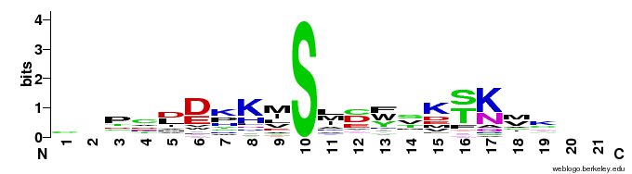
Prospective Sfp/PfAcpH active consensus
Top 43 peptide alignment (over 200k ‘RawIntDen’ with background subtraction)
Consensus Ybbr13
S6
A1
P.a. ACP
C | - | P | C | D | D | K | K | M | S | L | C | F | S | K | S | K | M | K
 |  |  |  |  |  |  |  | D | S | L | E | F | I | A | S | K | L | A
 |  |  |  |  |  |  | G | D | S | L | S | W | L | L | R | L | L | N
 |  |  |  |  |  |  | G | D | S | L | D | M | L | E | W | S | L | M
S | F | V | E | D | L | G | A | D | S | L | D | T | V | E | L | V | M | A

Slide 9
Caveats
Many of peptide hits contain multiple lysine (K) or arginine (R) residues, that could cause nonspecific binding to rhodamine-CoA
See spots A2 and A12 on membrane, corresponding to poly-arginine and poly-lysine, respectively
See file “2013-10-10_Peptide Hits.xls” for K/R amino acid content (also shows cysteine, but judging from poly-cysteine spot, this isn’t as likely)

Slide 10
Next steps
Evaluate synthesized consensus peptide hit from Training Set #1
Choose/synthesize best prospective hits from this peptide synthesis round (#2)
Hits sorted by number of K/R residue frequency seems like a good idea?
E.g. top scored hits from low K/R category…
ISAGYMVSKIQ = 1 lysine
LSVNYAVSKCR = 1 lysine & 1 arginine
ASMEYMMSKGK = 2 lysines

